Slide 1
Reasoning and Knowledge Representation Logical Agents

Slide 2
Outline
Knowledge-based agents
● Logic in general—models and entailment
● Propositional (Boolean) logic
● Equivalence, validity, satisfiability
● Inference rules and theorem proving
– forward chaining
– backward chaining
– resolution

Slide 3
Logical Agents
The agent must be able to
represent states, actions, etc.
incorporate new percepts
update internal representations of the world
deduce hidden properties of the world
deduce appropriate actions

Slide 4
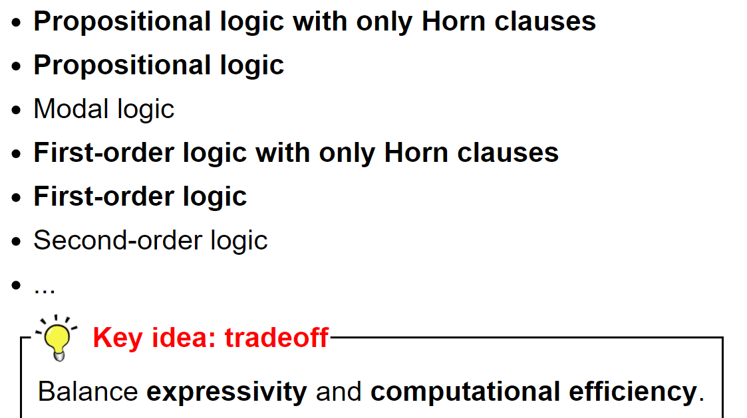
Logics

Slide 5
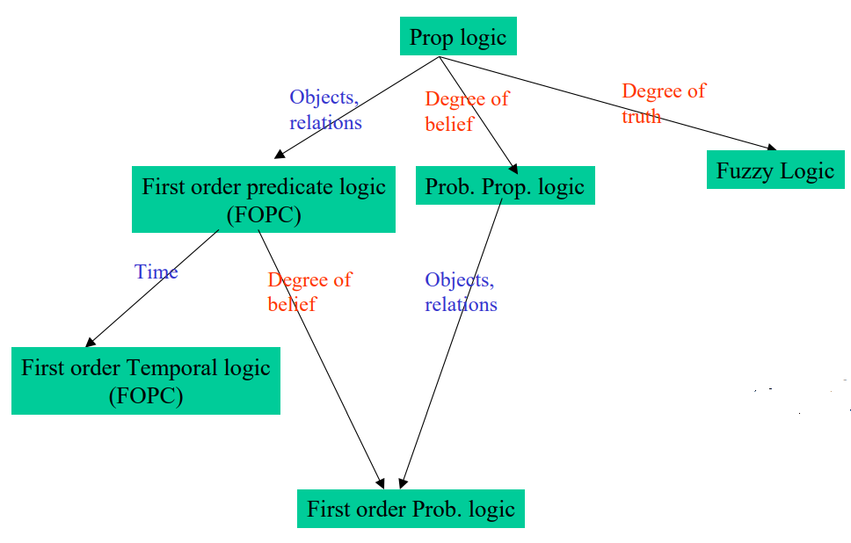
Types of Logics

Slide 6
Logic in General
Logics
- are formal languages for representing information such that conclusions can be drawn
Syntax
- defines the sentences in the language
Semantics
- define the "meaning" of sentences;
i.e., define truth of a sentence in a world

Slide 7
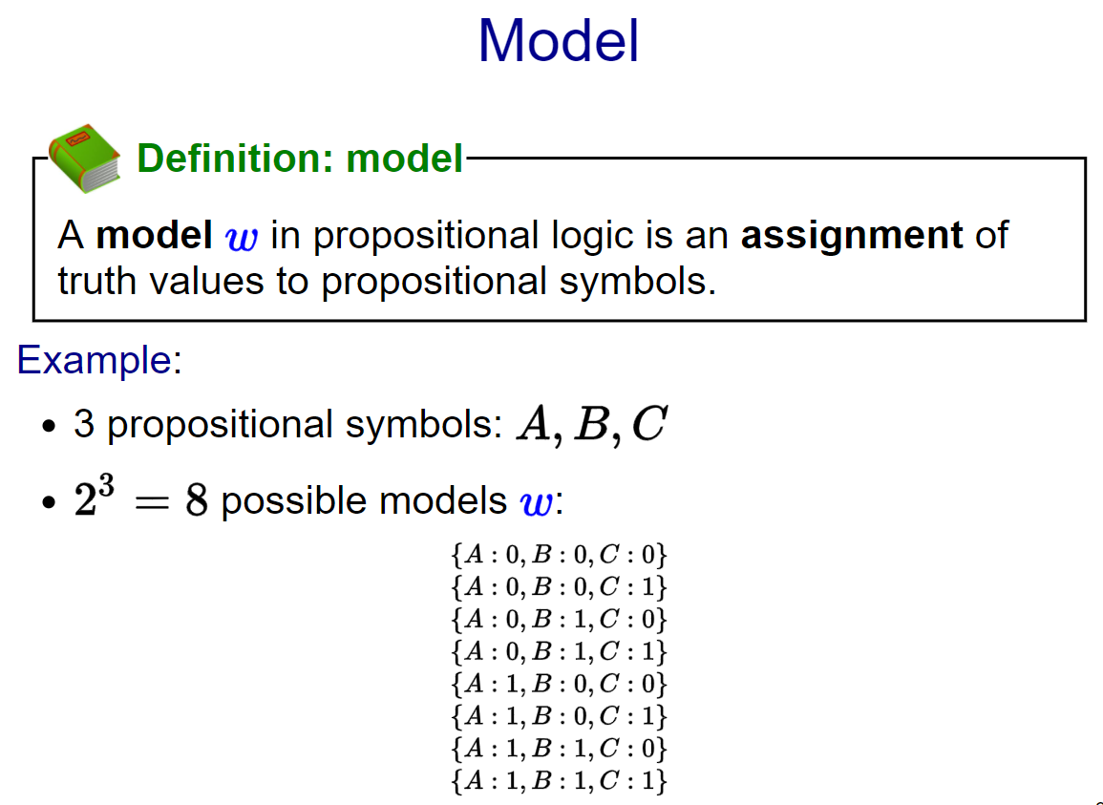

Slide 8
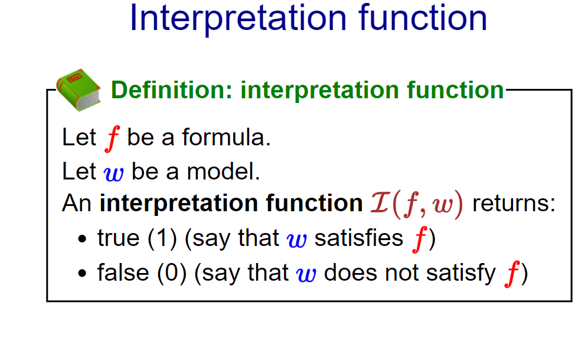

Slide 9
Representation of knowledge and the reasoning processes - central to the entire field of artificial intelligence - they enable successful behaviors that would be very hard to achieve otherwise.
Knowledge and reasoning also play a crucial role in dealing with partially observable environments - or example, a physician diagnoses a patient - infers a disease state that is not directly observable
Understanding natural language also requires inferring hidden state - "John saw the diamond through the window and coveted it “
- "John threw the brick through the window and broke it”

Slide 10
Knowledge Base
The central part of logical agents is knowledge base
-- set of sentences
-- each is some assertion about the world
Inferences – from knowledge bases

Slide 11
Propositional Logic

Slide 12
Example
Victor has been murdered, and Art, Bob, and Carl are suspects. Art says he did not do it. He says that Bob was the victim's friend but that Carl hated the victim. Bob says he was out of town the day of the murder, and besides he didn't even know the guy. Carl says he is innocent and he saw Art and Bob with the victim just before the murder. Assuming that everyone - except possibly for the murderer - is telling the truth,
Encode the facts of the case so that you can use the tools of Propositional Logic to convince people that Bob killed Victor.

Slide 13
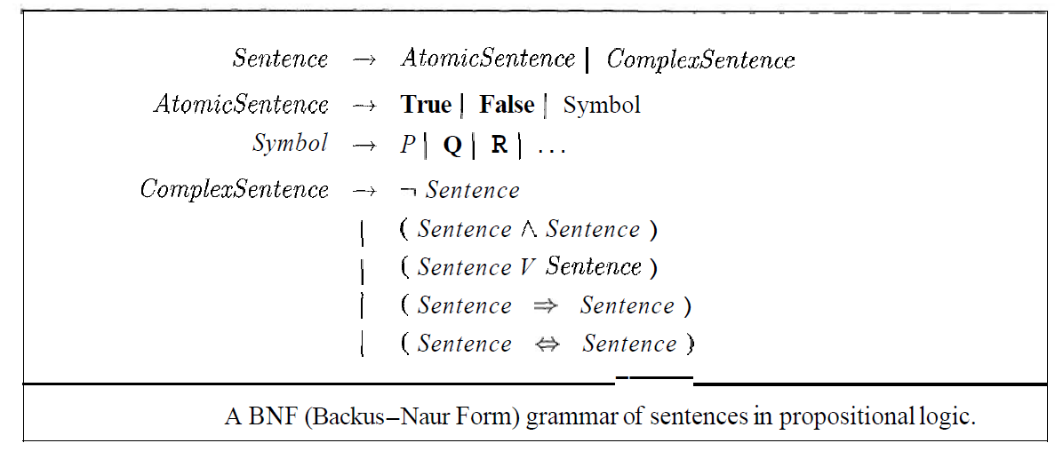
Propositional Logic

Slide 14
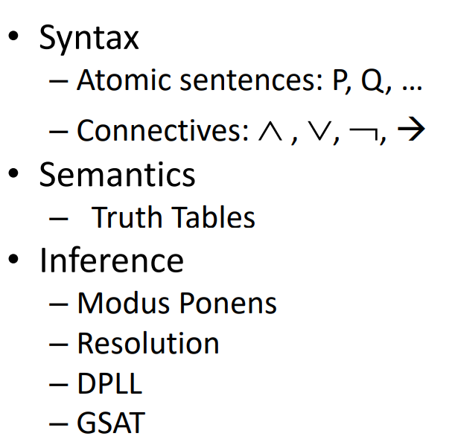
Propositional Logic

Slide 15
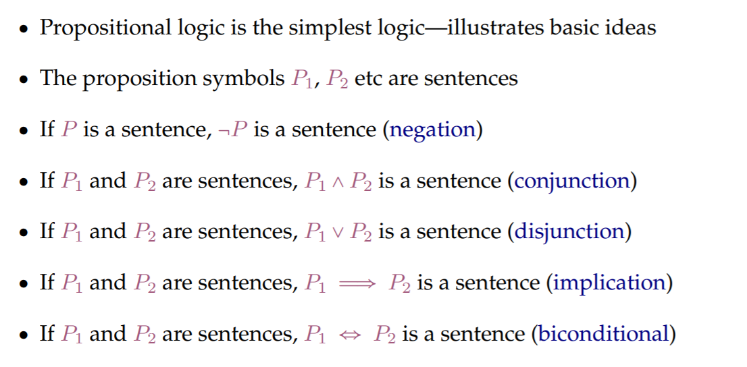
Propositional Logic

Slide 16
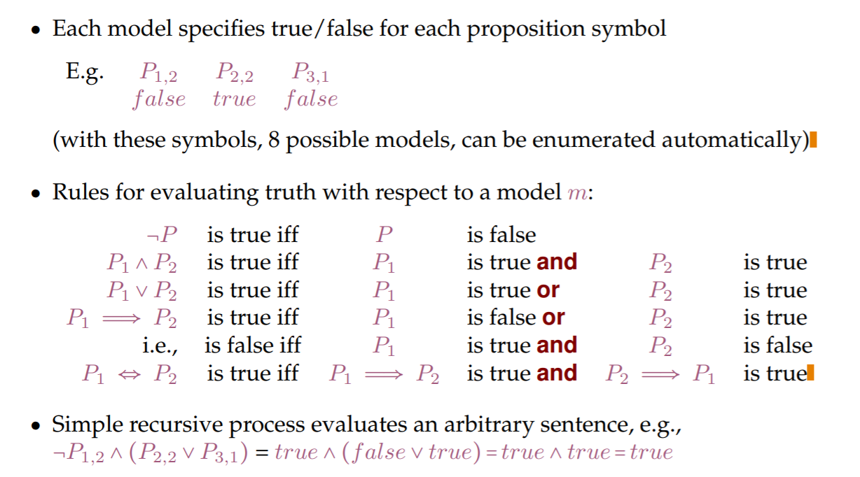
Propositional Logic

Slide 17
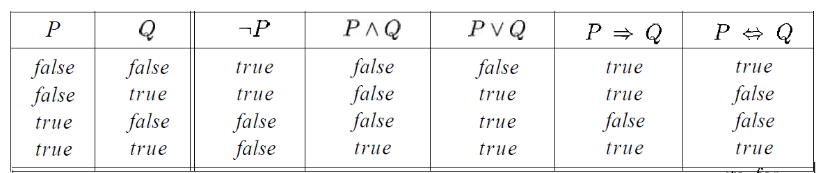
Truth Table
Some rules reduce truth of a complex sentence to truth of truth of simpler sentences

Slide 18
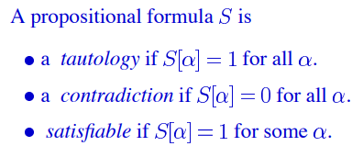

Special formulas

Slide 19
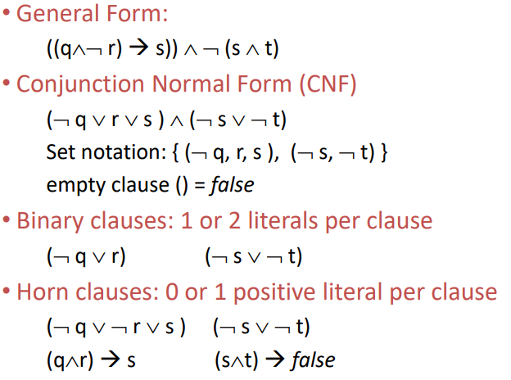
Special Syntactic forms

Slide 20
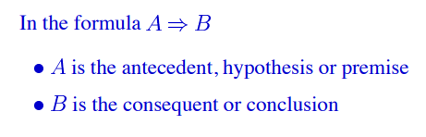
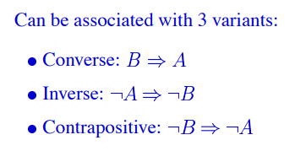
Implication

Slide 21
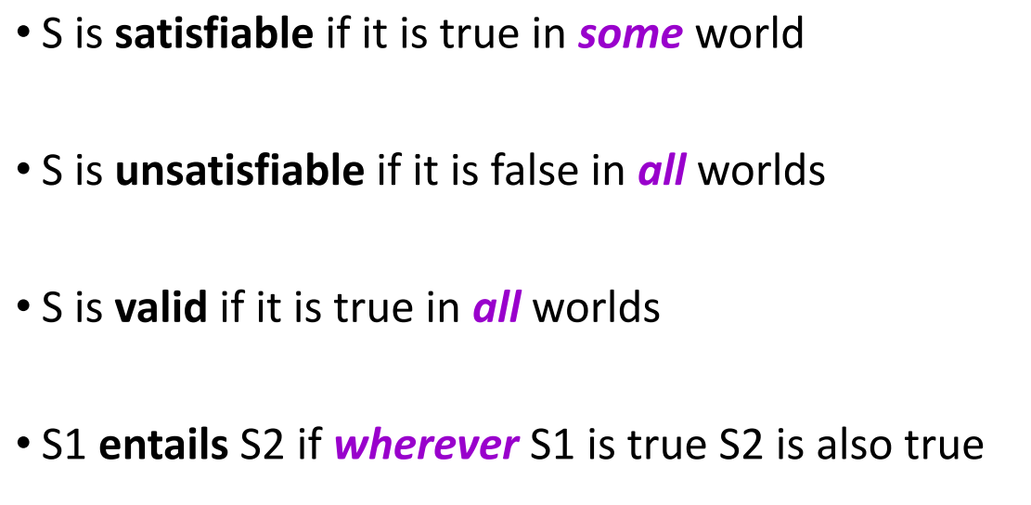
Validity and Satisfiability

Slide 22
Example
The following example is due to Lewis Carroll. Prove that it is a valid argument.
All the dated letters in this room are written on blue paper.
None of them are in black ink, except those that are written in the third person.
I have not filed any of those that I can read.
None of those that are written on one sheet are undated.
All of those that are not crossed out are in black ink.
All of those that are written by Brown begin with “Dear Sir.”
All of those that are written on blue paper are filed.
None of those that are written on more than one sheet are crossed out.
None of those that begin with “Dear sir” are written in the third person.
Therefore, I cannot read any of Brown’s letters.

Slide 23

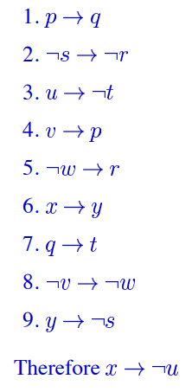



1. All the dated letters in this room are written on blue paper.
2. None of them are in black ink, except those that are written in the third person
3. I have not filed any of those that I can read
4. None of those that are written on one sheet are undated
5. All of those that are not crossed out are in black ink.
6. All of those that are written by Brown begin with “Dear Sir.”
7. All of those that are written on blue paper are filed.
8. None of those that are written on more than one sheet are crossed out.
9. None of those that begin with “Dear sir” are written in the third person.

Slide 24
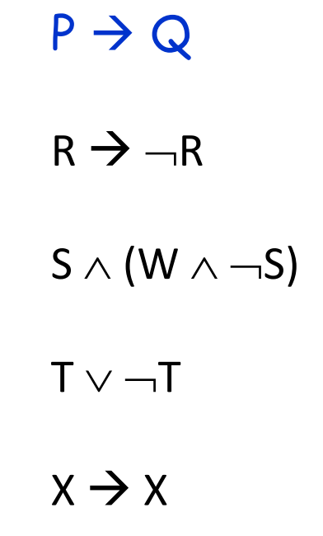
Examples

Slide 25
Propositional inference
Forward Chaining (Modis Ponens)
Backward Chaining (Search)
Resolution (Proof by contradiction)

Slide 26
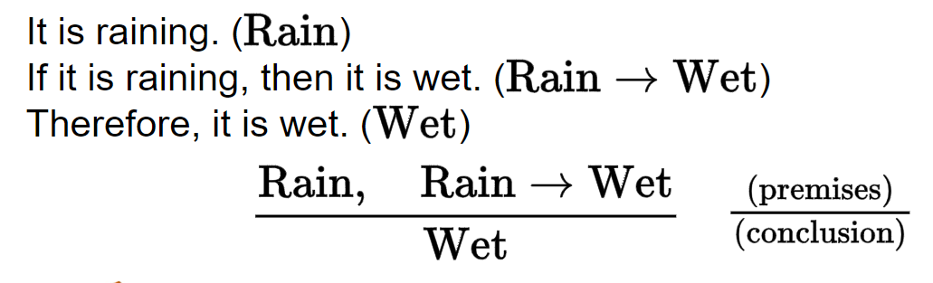
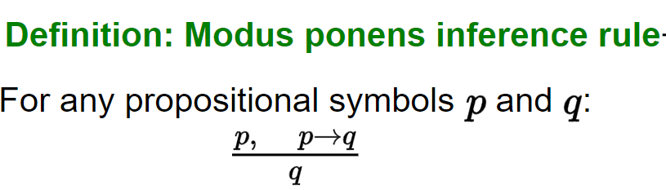
Inference rules

Slide 27
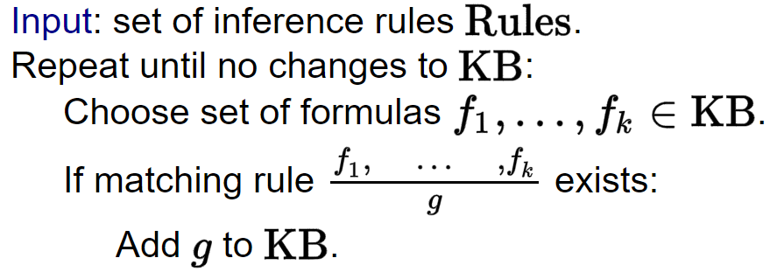
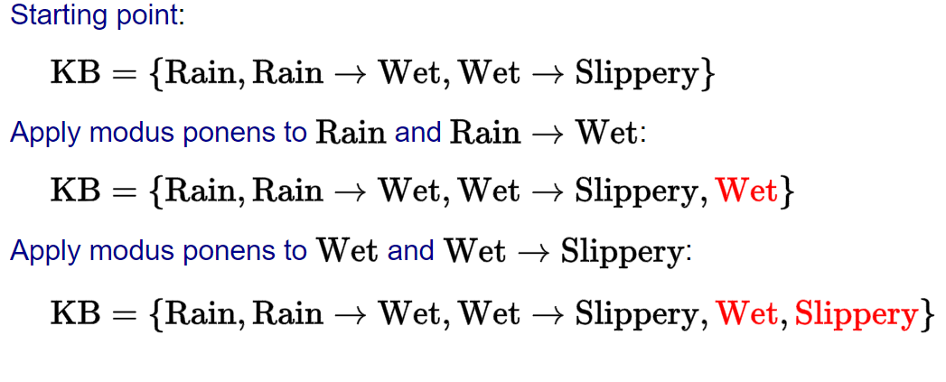
Inference algorithms
Forward Inference

Slide 28
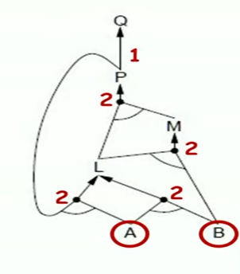
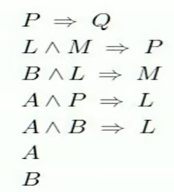
Forward Chaining
Q true ?

Slide 29
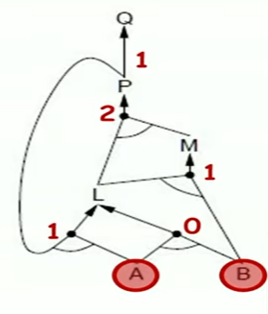
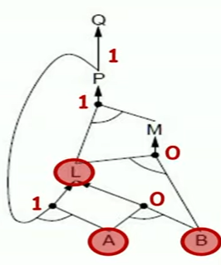
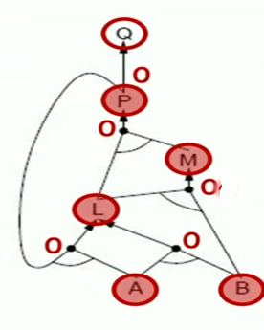
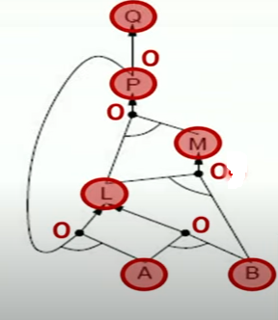
Forward Chaining

Slide 30
Resolution
Propositional Resolution is a powerful rule of inference
Works only on expressions in clausal form.
A literal is either an atomic sentence or a negation.
A clausal sentence is either a literal or a disjunction of literals.
A clause is the set of literals in a clausal sentence.
p; ¬p
p ¬p ¬p ∨ q
{p} {¬p} {¬p, q}

Slide 31
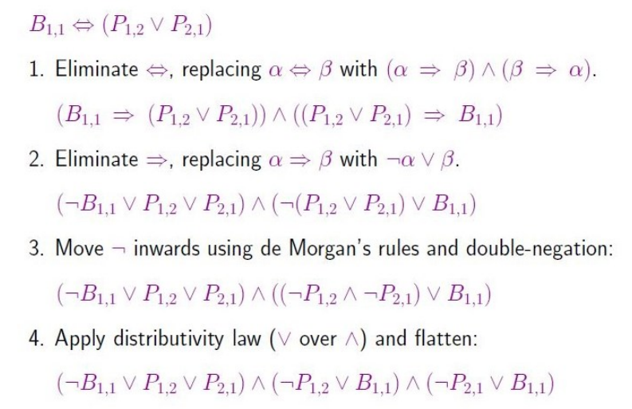
Conversion to CNF

Slide 32
Conversion to Clause form
(g ∧ (r ⇒ f))
¬(g ∧ (¬r ∨ f))
Implication
¬g ∨ ¬(¬r ∨ f) ¬g ∨ (¬¬r ∧ ¬f) ¬g ∨ (r ∧ ¬f)
Negation
(¬g ∨ r) ∧ (¬g ∨ ¬f)
Distribution
{¬g, r} {¬g, ¬f}
Operator

Slide 33
Resolution Principle
Suppose we have the clause {p, q} and clause {¬q, r}.
First clause: p is true or q is true.
Second clause : q is false or r is true
If q is false, then by the first clause p must be true.
If q is true, then, by the second clause, r must be true.
So we derive the clause {p, r}.

Slide 34
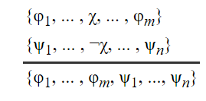
Resolution Principle
Given
a clause containing a literal χ and
another clause containing the literal ¬χ,
We can infer the clause consisting of all the literals of both clauses without the complementary pair.
Propositional Resolution or the Resolution Principle.

Slide 35
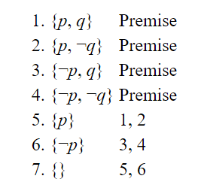
consider the clauses {p, q}, {p, ¬q}, {¬p, q}, and {¬p, ¬q} There is no truth assignment that satisfies all four of these clauses
Resolution Principle

Slide 36
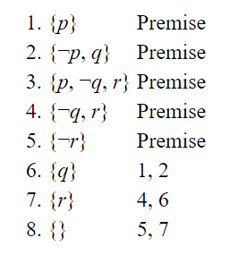
Consider three premises : p, (p ⇒ q), and (p ⇒ q) ⇒ (q ⇒ r). To prove r.
A resolution proof of a sentence φ from a set Δ of sentences is a resolution derivation of the empty clause from the clausal form of Δ ∪ {¬φ}
Resolution determines whether the resulting set is unsatisfiable.

Slide 37
Exercise
Use Propositional Resolution to show that the clauses
{p, q}, {¬p, r}, {¬p, ¬r}, {p, ¬q} are not simultaneously satisfiable.
2. Given the premises (p ⇒ q) and (r ⇒ s), use Propositional Resolution to prove the conclusion (p ∨ r ⇒ q ∨ s).

